Slide 1

Department of Computer Science and Engineering
Credit Card Fraud Detection
Date: 29 May 2021
A G Pooja Manas : 17WH1A0537
M.Sreelekha : 17WH1A0553
K.Priyanka : 17WH1A0538
Internal Guide : Ms. G. E. Padmavati
Designation : Assistant Professor
BVRIT HYDERABAD College of Engineering for Women

Slide 2

Abstract
Problem Statement :
It is vital that credit card companies are able to identify fraudulent credit card transactions so that customers are not charged for items that they did not purchase.The Credit Card Fraud Detection Problem includes modelling past credit card transactions with the data of the ones that turned out to be fraud. This model is then used to recognize whether a new transaction is fraudulent or not.
Project Objective :
Our objective here is to detect 100 percent of the fraudulent transactions while minimizing the incorrect fraud classifications
BVRIT HYDERABAD College of Engineering for Women

Slide 3
Dataset
The dataset contains transactions made by European cardholders. The dataset contains 492 frauds out of 186,000 transactions. Thus, it is highly unbalanced, with the positive (frauds) accounting for only 0.17%.
There are a total of 31 attributes since the data is highly confidential the attributes are taken as V1 to V28 all being numerical data. The remaining three attributes are time, amount which remains untransformed.
Attribute | Description
V1 to V28 | Numerical Data
Time | Seconds elapsed between each transition
Amount | Transaction amount
Class | Response variable with 1 as fraud and 0 otherwise.
BVRIT HYDERABAD College of Engineering for Women

Slide 4
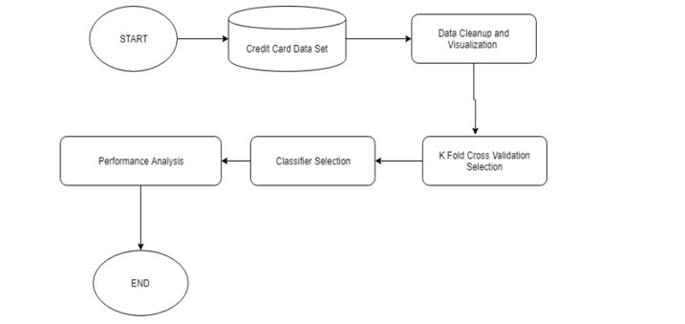
Architecture
BVRIT HYDERABAD College of Engineering for Women

Slide 5
Timeline
Review 0 | Identifying Business Case Requirement and Specifications
Review 1 | Studying and gathering the data
Review 2 | Data Preprocessing and Training the model
Review 3 | Visualisation and Interpretation of the results Report of the project
BVRIT HYDERABAD College of Engineering for Women

Slide 6
Technology Stack
Supervised Machine Learning
Language : Python
Packages Used :
NumPy
Pandas
Matplotlib
sklearn
BVRIT HYDERABAD College of Engineering for Women

Slide 7
Implementation
Random Forest - Random Forest algorithm belongs to the family of supervised learning algorithms. It Is a flexible, easy to use machine learning algorithm that produces, even without hyper-parameter tuning, a great result most of the time. It is also one of the most used algorithms, because of its simplicity and diversity.
Decision Trees - Decision Tree algorithm belongs to the family of supervised learning algorithms. The goal of using a Decision Tree is to create a training model that can use to predict the class or value of the target variable by learning simple decision rules inferred from prior data(training data).
BVRIT HYDERABAD College of Engineering for Women

Slide 8
Naive Bayes - It is a classification technique based on Bayes Theorem. The classifier assumes that the presence of a particular feature in a class is unrelated to the presence of any other feature.It has been successfully used for many purposes, but it works particularly well with natural language processing(NLP) problems.
Support Vector Machine(SVM) - SVM is a supervised machine learning model that uses classification algorithms for two-group classification problems. It chooses the extreme points/vectors that help in creating the hyperplane. These extreme cases are called support vector, and hence algorithm is termed as Support Vector Machine.

Slide 9
Output
The accuracies of the algorithms implemented are as follows:
Random Forest Algorithm:
Accuracy: 99.948%.
Decision Tree Algorithm:
Accuracy: 99.922%.
Naive Bayes Algorithm:
Accuracy: 97.849%.
Support Vector Machine (SVM):
Accuracy: 99.930%.

Slide 10
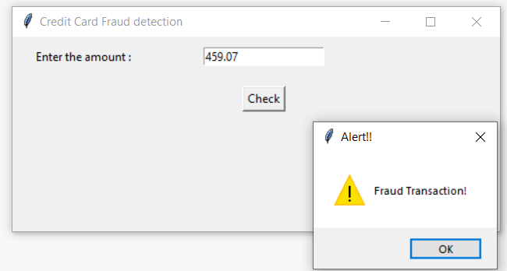
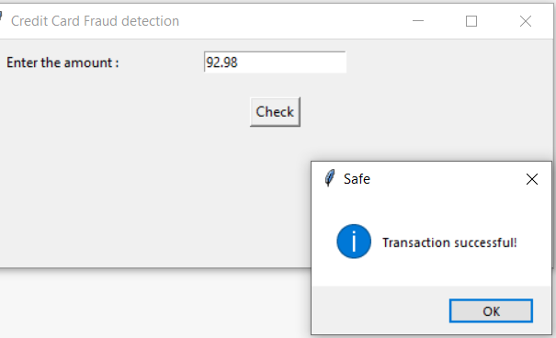
Visualisation
Tkinter :
TKinter is a python binding to the Tk GUI toolkit. It is the standard python interface to the Tk GUI toolkit and is python’s de facto standard GUI. Tkinter calls are transformed into Tcl commands, which are fed to this embedded interpreter. thus making it possible to mix python and Tcl in a single application.

Slide 11
Conclusion
After implementing the four algorithms namely: Random Forest, Decision tree algorithm, Naive Bayes Algorithm and Support Vector Machine algorithm, We came to a conclusion that:
The random forest algorithm is the best of four algorithms giving an accuracy of 99.948%.
The algorithm which gave the least accuracy among the four algorithms is Naive Bayes algorithm with an accuracy of 97.849%.
We detected the fraudulent credit card transactions and displayed “Fraud Transaction” message, restricting the customer to withdraw the money.
We displayed the “Transaction successful” message for the credit card transactions which are not fraudulent allowing the user to withdraw the money.
BVRIT HYDERABAD College of Engineering for Women

Slide 12
References
Base Paper
https://www.ijert.org/credit-card-fraud-detection-using-machine-learning-algorithms
Dataset
https://www.kaggle.com/mlg-ulb/creditcardfraud?select=creditcard
Credit Card Fraud Detection Based on Transaction Behaviour -by John Richard D. Kho, Larry A. Vea published by Proc. of the 2017 IEEE Region 10 Conference(TENCON), Malaysia, November 5-8,2019.
Credit Card Fraud Detection: A Realistic Modeling and a Novel Learning Strategy” published by IEEE TRANSACTIONS ON NEURAL NETWORKS AND LEARNING SYSTEMS, VOL. 29, NO. 8, AUGUST 2018.
Credit Card Fraud Detection through Parenclitic Network Analysis- By Massimiliano Zanin, Miguel Romance, Regino Criado, and Santiago Moral published by Hindawi Complexity Volume 2018, Article ID 5764370.
BVRIT HYDERABAD College of Engineering for Women

Slide 13
Thank you
BVRIT HYDERABAD College of Engineering for Women

